Slide 1
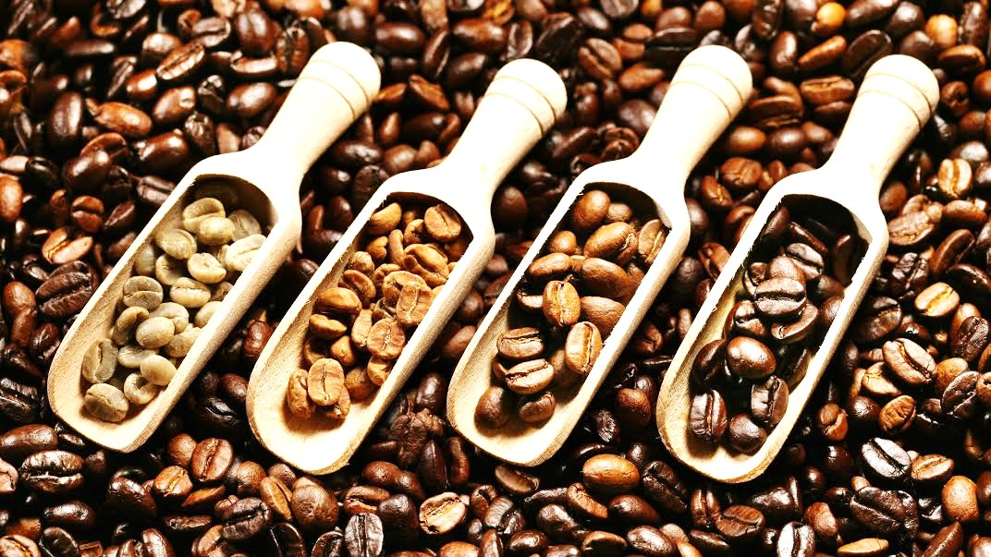
Coffee Quality Analysis

Slide 2
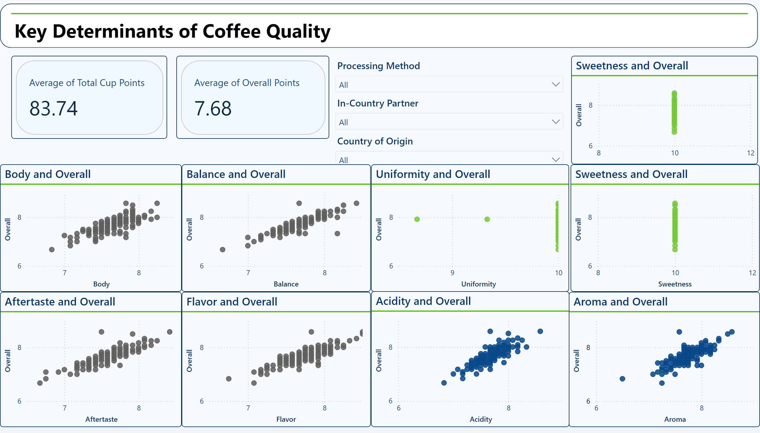
Key Determinants of Coffee Quality
Notes:
scatterChart
No alt text provided
scatterChart
No alt text provided
scatterChart
No alt text provided
scatterChart
No alt text provided
scatterChart
No alt text provided
scatterChart
No alt text provided
cardVisual
No alt text provided
slicer
No alt text provided
cardVisual
No alt text provided
scatterChart
No alt text provided
scatterChart
No alt text provided
slicer
No alt text provided
slicer
No alt text provided
shape
No alt text provided
textbox
No alt text provided
scatterChart
No alt text provided

Slide 3
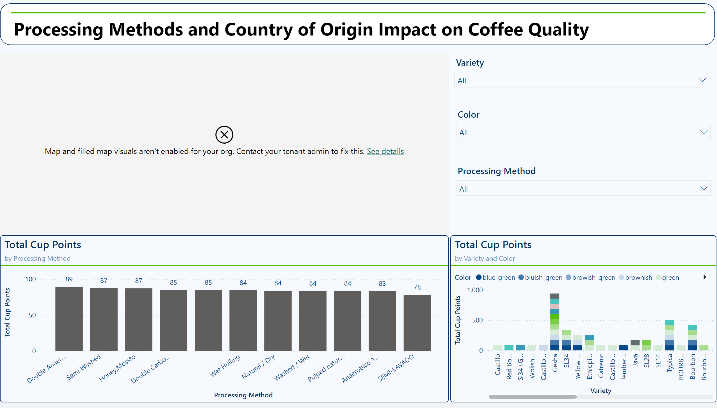
Processing Methods and Origin Impact on Coffee Quality
Notes:
columnChart
No alt text provided
map
No alt text provided
shape
No alt text provided
textbox
No alt text provided
columnChart
No alt text provided
slicer
No alt text provided
slicer
No alt text provided
slicer
No alt text provided

Slide 4
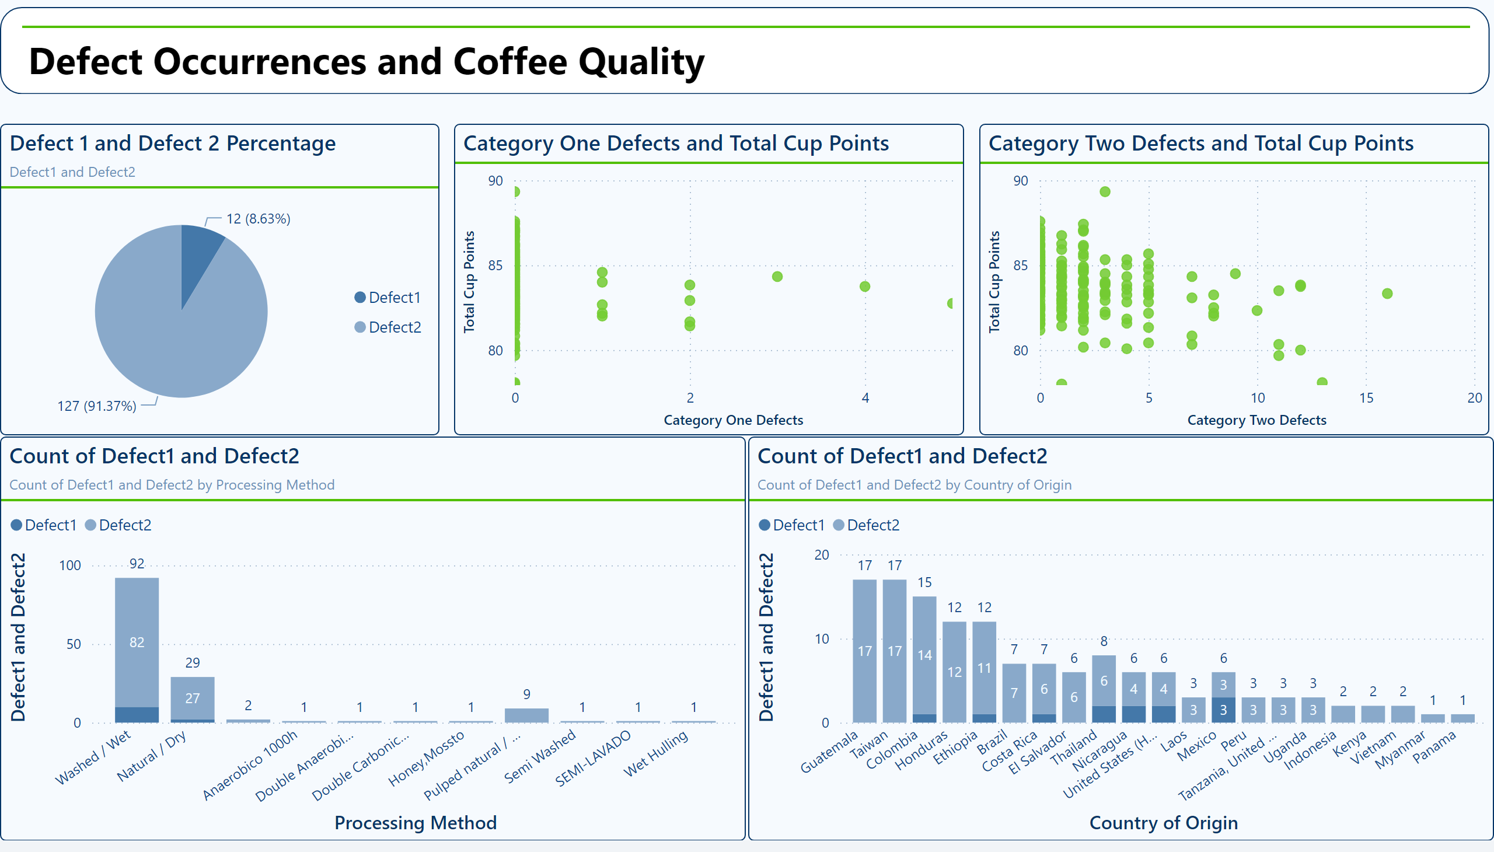
Defect Occurrences and Coffee Quality
Notes:
shape
No alt text provided
textbox
No alt text provided
Defect 1 and Defect 2 Percentage
No alt text provided
Count of Defect1 and Defect2
No alt text provided
scatterChart
No alt text provided
scatterChart
No alt text provided
Count of Defect1 and Defect2
No alt text provided

Slide 5
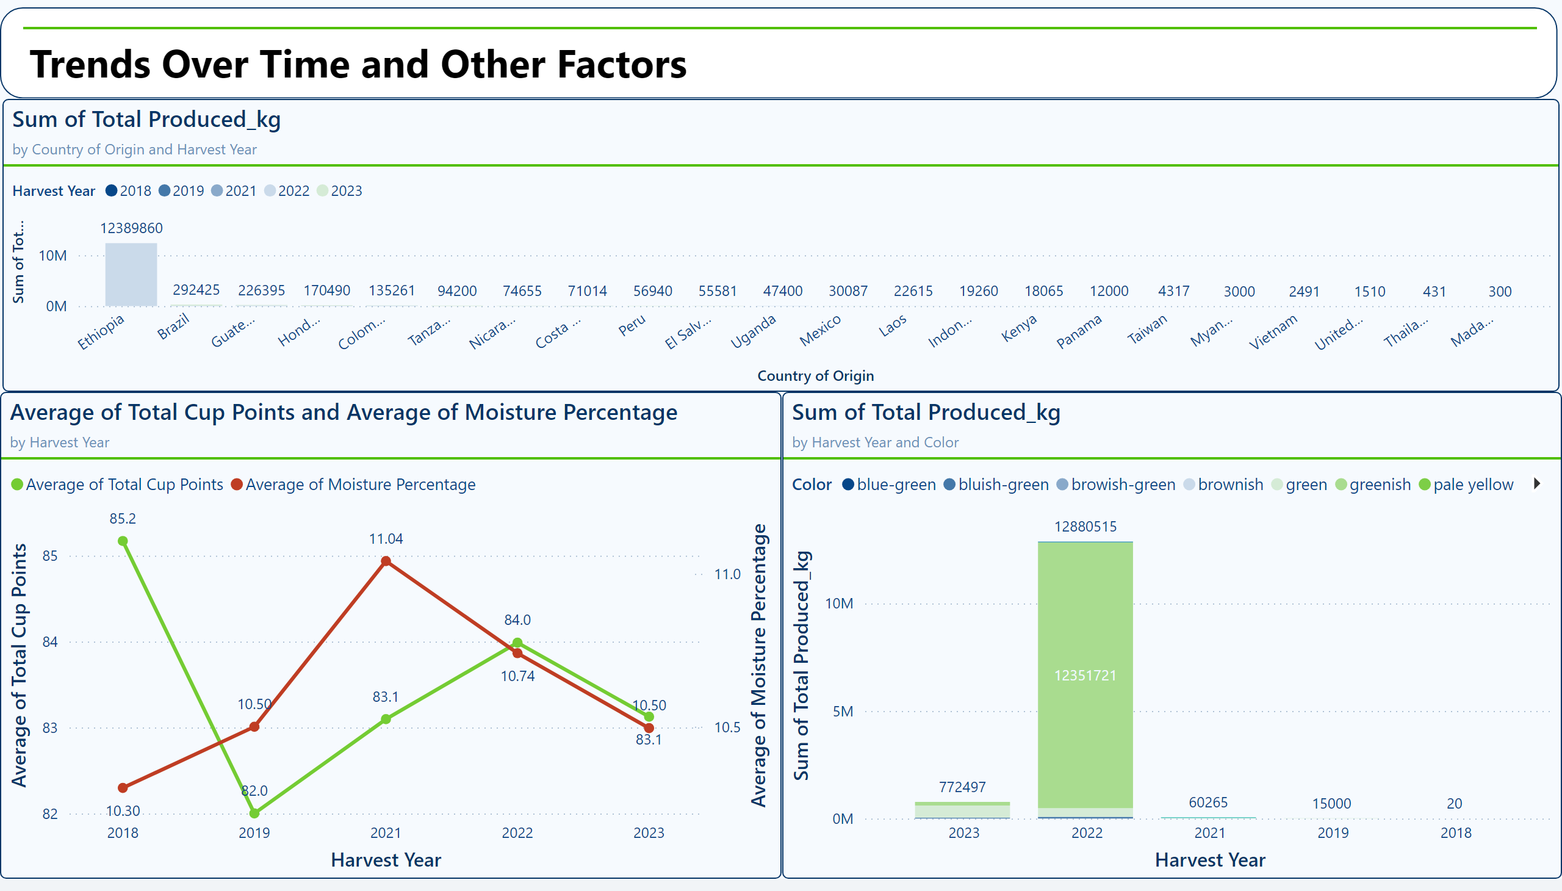
Trends Over Time and Other Factors
Notes:
shape
No alt text provided
textbox
No alt text provided
lineChart
No alt text provided
columnChart
No alt text provided
columnChart
No alt text provided

